Slide 1

ARCHITECTURE ANALYSIS & DESCRIPTION LANGUAGE (AADL)
KHAN HAFIZUR RAHMAN
SEMINAR
STUDENT, MASTERS IN SOFTWARE SYSTEM ENGINEERING
RWTH AACHEN

Slide 2
Introduction
WHEN :
WHO :
STANDARD :
NAME :
NOVEMBER, 2004
SOCIETY OF AUTOMATIVE ENGINEERS
AS5506
ARCHITECTURE ANALYSIS & DESIGN LANGUAGE (AADL)

Slide 3
WHAT IT DOES?
SPECIFYING REAL TIME EMBEDDED & HIGH DEPENDABILITY SYSTEM
ANALYZING COMPLEX SYSTEMS OF SYSTEMS
SPECIALISED PERFORMANCE CAPABILITY SYSTEMS
MAPPING SOFTWARE ELEMENTS WITH THE HARDWARE ELEMENTS

Slide 4
COMPONENT TYPES
APPLICATION SOFTWARE
EXECUTION SOFTWARE
COMPOSITE
THREAD, THREAD GROUP, PROCESS, DATA & SUBPROGRAM
PROCESSOR, MEMORY, DEVICE & BUS
SYSTEM CONSISTS OF OTHER SYSTEMS :BOTH SOFTWARE & HARDWARE

Slide 5
AADL MODEL EXAMPLE
Process
Tasks
producer
consumer
dataout
datain
20ms
thr
thr
20ms
Communication Interface
datain
dataout
Memory
Bus
Producer_ram
Consumer_ram
>
>
Processors
Producer_cpu
Consumer_cpu

Slide 6
SUMMARY OF AADL ELEMENT (SOFTWARE)
Component Type
Identifier
Extends (component_type)
Features
Flows
Properties
Components
Ports
Access
Subprogram
parameter
Data
Subprogram
Thread
Thread group
Process
Memory
Device
Processor
Bus
Property Set
Property types
Property definitions
Constraints
Component Implementation
Identifier
Extends {component implementation}
Refines type
Subcomponents
Connections
Modes
Flows
Properties
System
Package
Public
- declarations
Private
- declarations
Port
Access
parameter
Modes
Modes transitions
Annex Library
Legend
More details
References
Implements

Slide 7
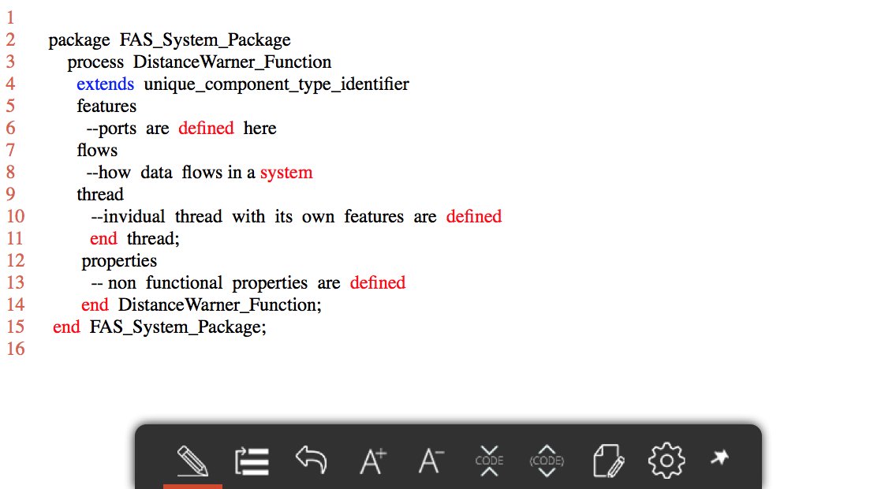
Component Declaration

Slide 8
CONNECTOR TYPE SYSTEM
REPRESENTS COMMUNICATION INTERFACE FOR THE DIRECTIONAL EXCHANGE
name : [descriptor] [source port] [connection symbol] [destination port]
3 DIFFERENT TYPES OF PORTS
DATA PORTS
EVENT PORTS
DATA – EVENT PORTS

Slide 9
DIFFERENT PORT TYPES
Data Port
TYPED STATE TRANSMISSION AMONG COMPONENTS
REPRESENTED BY TYPED VARIABLES
CONNECTIONS BETWEEN DATA PORTS ARE EITHER IMMEDIATE OR DELAYED
in
out
In out
>
Event port
>
Event data port

Slide 10
DIFFERENT PORT TYPES
Data Port
in
out
DIRECTIONAL EXCHANGE OF DATA
In out
>
Event port
>
Event data port

Slide 11
DIFFERENT PORT TYPES
Data Port
in
out
Used for Communication of events
Generated by subprograms, threads, processors or devices
Example : initiators of mode switches
In out
>
Event port
>
Event data port

Slide 12
DIFFERENT PORT TYPES
Data Port
in
out
Enable the queuing of data associated with an event.
Example : modeling message communication with queuing message at the recipient. Message arrival may cause dispatch of the recipient and allow recipient to process one or more messages.
In out
>
Event port
>
Event data port

Slide 13
MODULARITY
AADLib
REUSABLE AADLv2 COMPONENTS, ASSOCIATED PROPERTY SETS
LIBRARY OF EXAMPLES
ANNEX LIBRARY
SUBLANGUAGE CAN BE USED IN ANNEX SUBCLAUSES WITH COMPONENT TYPE & IMPLEMENTATION DECLARATION
DIFFERENT TYPES OF ANNEXES FOR DIFFERENT FUNCTIONS.

Slide 14
DIFFERENT TYPES OF ANNEXES
GRAPHICAL AADL NOTATION
DEFINES A SET OF GRAPHICAL SYMBOL
EXPRESS RELATIONSHIPS BETWEEN COMPONENTS, FEATURES & CONNECTIONS
AADL META MODEL & INTERCHANGE FORMATS
META MODEL DEFINES STRUCTURE OF MODELS
INTERCHANGE FORMATS IN XML BASED FOR AADL MODELS
LANGUAGE COMPLIANCE & APPLICATION PROGRAM INTERFACE
DEFINES LANGUAGE-SPECIFIC RULES FOR SOURCE-TEXT TO BE COMPLIANT WITH ARCHITECTURE SPECIFICATION WRITTEN IN AADL
ERROR MODEL ANNEX
FEATURES TO ENABLE SPECIFICATION OF REDUNDANCY MANAGEMENT & RISK MITIGATION METHODS IN AN ARCHITECTURE.

Slide 15
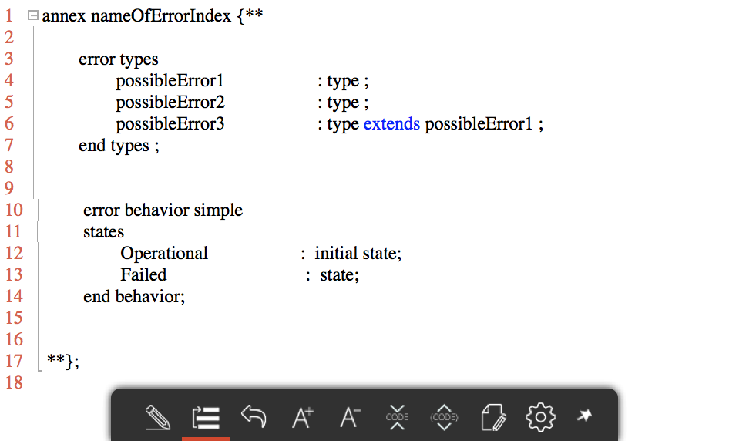
ERROR MODEL ANNEX

Slide 16
BINDINGS
MAPPING BETWEEN SOFTWARE COMPONENT & EXECUTION PLATFORM
ALLOWED_MEMORY_BINDING IDENTIFIES POSSIBLE MEMORY COMPONET FOR BINDING
ACTUAL_MEMORY_BINDING SPECIFY MEMORY COMPONENT WHERE CODE & DATA FROM SOURCE TEXT IS BOUND
AVAILABLE_MEMORY_BINDING PROPERTY SPECIFIES SET OF CONTAINED MEMORY COMPONENTS AVAILABLE FOR BINDING INTERNAL COMPONENTS FROM OUTSIDE THE SYSTEM

Slide 17
COMMUNICATION OTHER THAN CONNECTORS
SUBCOMPONENT ACCESS
SUBPROGRAM CALLS
PARAMETER CONNECTIONS

Slide 18
COMMUNICATION OTHER THAN CONNECTORS
SUBCOMPONENT ACCESS
DECLARE FEATURE DECLARATION IN COMPONENT TYPE EXPLICITELY
DATA & BUS SYSTEMS ARE ACCESSIBLE
TWO TYPES OF DECLARATION : PROVIDES AND ACCESS
PROVIDE ALLOWS TO ACCESS DATA OR BUS COMPONENT CONTAINED IN IT
REQUIRES INDICATE A COMPONENT REQUIRES ACCESS TO A DATA OR BUS COMPONENT EXTERNAL TO IT.

Slide 19
COMMUNICATION OTHER THAN CONNECTORS
SUBPROGRAM CALLS
DECLARE CALL WITHIN A THREAD
INVOKED SUBPROGRAM MUST BE DECLARED THROUGH A SUBPROGRAM TYPE DECLARATION & AS WELL AS IMPLEMENTATION
TWO TYPES OF CALL : CALL SEQUENCES & REMOTE CALLS

Slide 20
COMMUNICATION OTHER THAN CONNECTORS
PARAMETER CONNECTIONS
PARAMETER ( PASSING BY VALUE)
REPERESENT CALL & RETURN DATA VALUES PASSED INTO & OUT OF SUBPROGRAMS
ACCESS (PASSING BY REFERENCE)
REFERENCE CAN BE DONE BY POINTER VALUES
GLOBAL/STATIC (SHARED) DATA
COMMON DATA VALUES

Slide 21
TOOL SUPPORT
OSATE2
BASED ON ECLIPSE & ECLIPSE FRAMEWORK
SUPPORTS CORE LANGUAGE
PLUGIN SUPPORT SUPPORTS EXTENDABILITY
PROVIDE GRAPHICAL VISUALIZATION
LUTE CONSTRAINTS LANGUAGE
AADL INSPECTOR
LIGHTWEIGHT STANDALONE MODEL PROCESSING FRAMEWORK
SPECIALLY FOR INDUSTRIAL USERS
IMPORT TEXTUAL SPECIFICATIONS, STATIC RULE ANALYSIS, SCHEDULABILITY ANALYSIS ETC.
OCARINA
TOOL FOR CODE GENERATION, MODEL PARSING, VALIDATION & VERIFICATION

Slide 22
AADL ANALYSIS
DATAFLOW ANALYSIS
3 DIFFERENT TYPES OF FLOWS : FLOW SPECIFICAITON, FLOW IMPLEMENTATION, END TO END FLOW
DETERMINE LATENCY OF FLOW IMPLPEMENTAITONS DECLARED FOR COMPONENTS & COMAPRE WITH THE CORRESPONDING COMPONENT FLOW SPECIFICATION
LATENCY OF A FLOW IMPLEMENTATION = SUM OF EACH COMPONENT DECLARED LATENCY VALUE
THREAD, DEVICE ,BUS ARE LATENCY CONTRIBUTORS
RESULTING LATENCY VALUE IS STORED IN FLOW IMPLEMENTATIN LATENCY SPECIFICATION

Slide 23
AADL ANALYSIS (CONTINUED)
WHAT IS FAULT TREE ANALYSIS
USEFUL ANALYTICAL TOOL FOR RELIABILITY & SAFETY IN A COMPLEX SYSTEM
ANALYZE FAULT TREE TO DETERMINE MINIMAL CUT SETS
COMPUTE PROBABILTY FOR OCCURRENCE COMPUTATION
MINIMAL CUT SETS ARE THE SMALLEST COMBINATION OF FAULT EVENTS WHICH LEAD TO A SYSTEM FAIURE

Slide 24
AADL ANALYSIS (CONTINUED)
HOW FAULT TREE ANALYSED IN AADL
FAULT SAFETY RELATED INFORMATION IS ANNOTATED IN ERROR MODEL V2
FOCUSED ON COMMON CAUSE LIKE DEPENDENT EVENTS & SUB TREES.
AADL FIRST DEVELOP GRAPH & TRANSFORM INTO TREE USING TWO TRANSFORMATIONS
FLATTENING OF NESTED GATE WHERE GATES REPRESENT N-ARY LOGICAL OPERATIONS
MOVING EVENTS AS TARGET OF MULTIPLE REFERENCES TOWARDS THE ROOT TO REDUCE OR ELIMINATE MULTIPLE REFERENCES.

Slide 25
QUESTIONS?
COMMENTS?
SUGGESTIONS?

